Slide 1
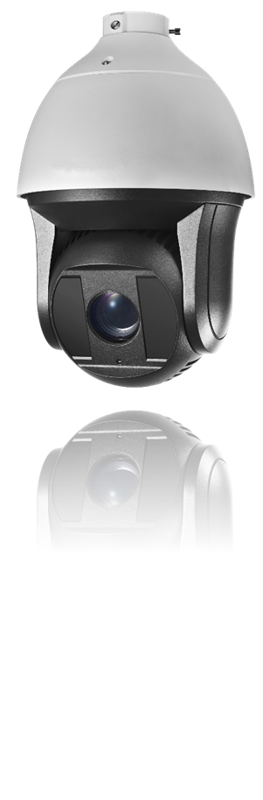











HNP508A-IR/36X
8MP Smart PTZ Camera
4K series smart PTZ dome cameras are able to capture high quality colored images in dim light environments, due to their cutting-edge low illumination level of 0.02 Lux (color). The embedded 1/1.9" progressive scan CMOS chip makes WDR and 8MP real-time resolution possible. With the 36X optical zoom Day/Night lens, the camera covers more details over expansive areas.
The 4K series PTZ camera also features a wide range of smart functions, including intrusion detection, line crossing detection and audio exception, benefitting users with great improvement on security efficiency, more importantly, with key events / objects being recorded for further forensic needs. These features, combined with smart tracking, enable the camera to detect any progressively moving object and follow it within the camera’s area of coverage without fault. Smart Defog is further supported to improve image quality in challenging conditions.
Key Features
1/1.9” HD CMOS sensor
Optical Defog
8MP(4096*2160) Full HD
36X Optical Zoom
Ultra-low illumination
120dB True WDR
Smart Tracking
Smart Detection
EIS (Electronic Image Stabilization)
200m IR distance
Hi-PoE / 24VAC power supply

Slide 2
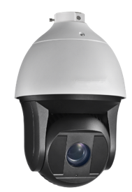
HNP508A-IR/36X
8MP Smart PTZ
Function Description
Basic function:
High performance CMOS, up to 4096x2160resolution
±0.1° Preset Accuracy
ONVIF(Open Network Video Interface Forum), CGI(Common Gateway Interface), PSIA(Physical Security Interoperability Alliance), to ensure greater interoperability between different platforms and compatibility
3D intelligent positioning function
3D DNR
IP66 standard
7 alarm inputs and 2 alarm outputs
Scheduled PTZ movement
Optional wiper(-W)
Smart function:
Smart tracking modes: Manual/ Panorama/ Intrusion trigger/ Line crossing trigger/ Region entrance trigger/ Region exiting trigger, support smart tracking when patrol between multiple scenarios
Smart detection: support Face detection, Intrusion detection, Line crossing detection, Audio exception detection, Region entrance detection, Region exiting detection
Smart recording: support edge recording, support dual-VCA for smart search in smart NVR
Smart image processing: support optical defog, HLC, smart IR, EIS
Smart codec: low bit rate, ROI
Camera function:
Auto iris, auto focus, auto white balance, backlight compensation and auto day & night switch
Min. Illumination: 0.02Lux@(F1.5,AGC ON)(Color), 0.002Lux@(F1.5,AGC ON)(B/W)
Support privacy mask with multiple colors and mosaics on polygonal areas
PTZ function:
360° endless pan range and -20°~ 90° tilt range
240°/s Pan Preset Speed and 200°/s Tilt Preset Speed
0.1°~ 300°/s Manual Pan Speed and 0.1°~ 120°/s Manual Tilt Speed
300 presets programmable; preset image freezing capability
8 patrols, up to 32 presets per patrol
4 patterns, with the recording time not less than 10 minutes per pattern
Proportional zoom function
Park action: auto call up of PTZ movement, after a defined time of inactivity
Power-off memory: restore PTZ & Lens status after reboot
Network function:
H.264/MJPEG/MPEG4 video compression
H.264 encoding with Baseline/Main/High profile
ROI(Region of Interest) encoding(support 24 areas with adjustable levels)
Built-in Web server
Onboard storage, up to 128GB
Support up to 8 NAS storage; Edge recording(transmit the videos from SD card to the NAS after network resumed)
HTTPS encryption and IEEE 802.1X port-based network access control
Support trip-streams
Multiple network protocols supported: IPv4/Ipv6, HTTP, HTTPS, 802.1X, QoS, FTP, SMTP, UPnP, SNMP, DNS, DDNS, NTP, RTSP, RTP, TCP, UDP, IGMP, ICMP, DHCP, PPPoE
1 audio input and 1 audio output
IR function:
0 Lux minimum illumination
Up to 200m IR distance
IR light MTBF reaching up to 30,000 hours

Slide 3
HNP508A-IR/36X
8MP Smart PTZ
Model | HNP508A-IR/36X
Camera Module
Image Sensor | 1/1.9’’ Progressive Scan CMOS
Min. Illumination | F1.5, 50IRE, AGC On: Color: 0.002 lux, B/W : 0.0002 lux, 0 lux with IR
Max. Image Resolution | 4096x2160
Focal Length | 5.7-205.2, 36x
Digital Zoom | 16X
Zoom Speed | Approx.7.4s(Optical Wide-Tele)
Angle of View | 56.8-2.02°(Wide-Tele)
Min. Working Distance | 10-1500mm(Wide-Tele)
Aperture Range | F1.55~F4.8
Focus Mode | Auto / Semiautomatic / Manual
WDR | 120dB
Shutter Time | 50Hz: 1~1/30,000s; 60Hz: 1~1/30,000s
AGC | Auto / Manual
White Balance | Auto / Manual /ATW/Indoor/Outdoor/Daylight lamp/Sodium lamp
Day & Night | IR Cut Filter
Privacy Mask | 24 privacy masks programmable; optional multiple colors and mosaics
Optical Defog | Support
Enhancement | 3D DNR, EIS, HLC/BLC, SVC
Pan and Tilt
Range | Pan:360° endless; Tilt: -20°~90°(Auto Flip)
Speed | Pan Manual Speed: 0.1°~160°/s, Pan Preset Speed: 240°/s Tilt Manual Speed: 0.1°~120°/s, Tilt Preset Speed: 200°/s
Number of Preset | 300
Patrol | 8 patrols, up to 32 presets per patrol
Pattern | 4 patterns, with the recording time not less than 10 minutes per pattern
Park Action | Preset / Patrol / Pattern / Auto scan / Tilt scan / Random scan / Frame scan / Panorama scan
Scheduled Task | Preset / Patrol / Pattern / Auto scan / Tilt scan / Random scan / Frame scan / Panorama scan/Dome reboot/Dome adjust/Aux output
Smart Features
Smart tracking | Manual/ Panorama/ Intrusion trigger/ Line crossing trigger/ Region entrance trigger/ Region exiting trigger Smart tracking when patrol between multiple scenarios
Smart detection | Face detection, Intrusion detection, Line crossing detection, Audio exception detection, Region entrance detection, Region exiting detection
ROI encoding | Support 24 areas with adjustable levels
Infrared
IR Distance | Up to 200m
IR Intensity | Automatically adjusted, depending on the zoom ratio
Alarm
Alarm I/O | 7/2
Alarm Trigger | Face detection, Intrusion detection, Line crossing detection, Region entrance, Region exiting, Audio exception detection, Motion detection, Dynamic analysis, Tampering alarm, Network disconnect, IP address conflict, Storage exception
Alarm Action | Preset, Patrol, Pattern, Micro SD/SDHC card recording, Relay output, Notification on Client, Send Email, Upload to FTP, Trigger Channel
Input/Output
Monitor Output | 1.0V[p-p] / 75Ω, NTSC (or PAL) composite, BNC (S/N ratio≥ 55dB)
Audio Input | 1 Mic in/Line in interface, line input: 2-2.4V[p-p]; output impedance: 1KΩ, ±10%
Audio Output | 1 Audio output interface, line level, impedance: 600Ω
Network
Ethernet | 10Base-T / 100Base-TX, RJ45 connector
Main Stream | 50 Hz: 25 fps (4096 × 2160, 3840 × 2160, 3072 × 1728, 2560 × 1440, 1920 × 1080, 1280 × 720) 60 Hz: 24 fps (4096 × 2160), 30 fps (3840 × 2160, 3072 × 1728, 2560 × 1440, 1920 × 1080, 1280 × 720)
Sub Stream | 50 Hz: 25 fps (704 × 576, 352 × 288, 176 × 144); 60 Hz: 30 fps (704 × 480, 640 × 480, 352 × 240)
Third Stream | 50 Hz: 25 fps (704 × 576, 352 × 288, 176 × 144); 60 Hz: 30 fps (704 × 480, 640 × 480, 352 × 240)
Image Compression | H.264/MJPEG/MPEG4, H.264 encoding with Baseline/Main/High profile

Slide 4

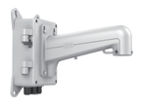
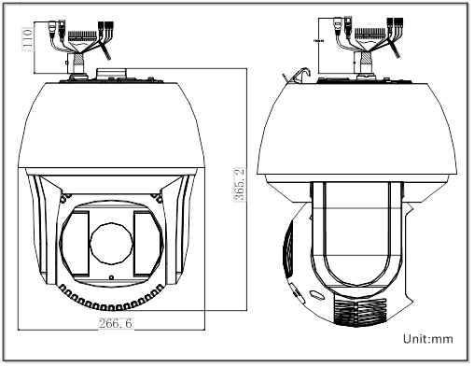
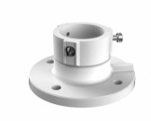
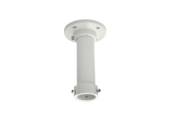
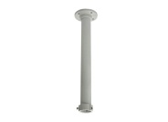

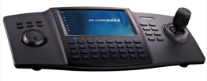

HNP508A-IR/36X
8MP Smart PTZ
Audio Compression | G.711ulaw/G.711alaw/G.726/MP2L2/G.722/PCM
Protocols | IPv4/IPv6, HTTP, HTTPS, 802.1X, QoS, FTP, SMTP, UPnP, SNMP, DNS, DDNS, NTP, RTSP, RTP, TCP, UDP, IGMP, ICMP, DHCP, PPPoE
Simultaneous Live View | Up to 20 users
Mini SD Memory Card | Support up to 128GB Micro SD/SDHC/SDXC card. Support Edge recording
User/Host Level | Up to 32 users,3 Levels: Administrator, Operator and User
Security Measures | User authentication (ID and PW); Host authentication (MAC address); IP address filtering
System Integration
Application programming | Open-ended API, support ONVIF, PSIA, CGI and Genetec
Web Browser | IE 7+, Chrome 18 +, Firefox 5.0 +, Safari 5.02 +, support multi-language
RS-485 Protocols | HIKVISION, Pelco-P, Pelco-D, self-adaptive
Power | High-PoE&24 VAC, Max.60W
Working Temperature | -40°C ~ 65°C (-40°F ~ 149°F)
Humidity | 90% or less
Protection Level | IP66, IK10, TVS 6,000V lightning protection, surge protection and voltage transient protection
Certification | FCC, CE, UL, RoHS, IEC/EN 61000, IEC/EN 55022, IEC/EN 55024, IEC /EN60950-1
Dimensions | Φ266.6(mm)×365.2(mm)
Weight (approx.) | 8kg (approx.)
Dimensions
Accessories
Wall Mount
Conner Mount
Pole Mount
Box Mount
Celling mount
Pendant mount
Pendant mount
Swan-neck Mount
Network Keyboard
USB Joy-stick

